Slide 1
Distributed Algorithms Introduction
刘盛云

Slide 2

Course
星期四 16:00-17:40
办公室: 软件大楼5209办公室
邮箱：shengyun.liu@sjtu.edu.cn
平时成绩 （10%）
练习
课程中给出(20%)
考试
判断题，算法题(70%)
Parts of slides for DistAlg, Eurecom by Marko Vukolic, modified by Shengyun Liu
微信群

Slide 3
Literature
Textbook
C. Cachin, R. Guerraoui, L. Rodrigues: Introduction to Reliable and Secure Distributed Programming, Springer.
Optional
M. Raynal. Fault-Tolerant Message-Passing Distributed Systems: An Algorithmic Approach, Springer.

Slide 4
Outline
This course
What, why?
Challenges
Goals

Slide 5
Distributed Algorithms
We study algorithms used in distributed systems
In contrast to sequential algorithms for centralized systems
What is a distributed system?
A set of processes/nodes
seeking to achieve some common goal
by communicating with each other
Processes/nodes: cores, processors, physical/virtual machines, clusters

Slide 6





The simplest form of distributed systems
Client–server interactions
monthly active users: 172 million
Game of Thrones

Slide 7


Another scenario
Client–server interactions
monthly active users: 700 million
transfer(Alice, Bob, ¥10)
confirm
confirm
Alice
Bob

Slide 8





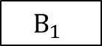
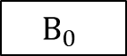
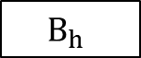
One more scenario
transfer(From: Alice, To: Bob, Amount: 1)
…
$$B_{0}$$
$$B_{1}$$
…
$$B_{h}$$
…
Blockchain
1
consensus
Alice
1
Bob

Slide 9
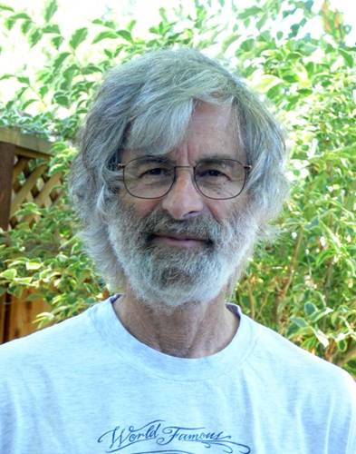
Lamport’s Turing lecture
The Computer Science of Concurrency: The Early Years
“I don’t know if concurrency is a science, but it is a field of computer science.”

Slide 10
Distributed computing (history)
1960s ~ E. Dijkstra (concurrency, mutual exclusion)
1970s ~ J. Gray, L. Lamport (transactions, replication, Byzantine)
1980s ~ N. Lynch (consensus)
1990s ~ H. Attiya (broadcast, shared memory)
2000s ~ Large scale networked systems (DHTs, P2P,…)
2010s ~ Cloud Computing, Machine learning, Blockchain

Slide 11
What common goals?
Processes work together
Generic common goal
Compute a function on the global system state
But… processes have only a local view of the system

Slide 12
More specific common goals
Aggregate functions
E.g., sensors calculating average temperature
Model aggregation in machine learning
Information dissemination
Broadcast primitives
Synchronization
Agreement, consensus
Leader election

Slide 13
Common goals: examples
Reliable broadcast
Ensure that a message sent to a group is received by all or none
Consensus
Ensure that processes agree on the input of one of them
Atomic commit
Ensure that processes reach a common decision whether to commit or abort a transaction
Multi-Party Computation
Ensure that processes jointly compute a function over their inputs while keeping those inputs private

Slide 14
A set of processes: why?
Inherent (genuine) distribution
Sensor, mobile ad-hoc networks
Peer-to-peer networks
Online collaboration
...
Distribution as an engineering artifact
Engineering choices
Fault-tolerance, performance optimizations
Replication (e.g., databases)
Multicores, …

Slide 15
Architecture
Between application and communication channels (network, shared memory)
Application
Application
Dist. Algorithms
Dist. Algorithms
Channels
(TCP/IP, UDP, shared memory, …)
Channels
(TCP/IP, UDP, shared memory, …)

Slide 16
Communication
In order to achieve a common goal processes need to communicate
Message passing
Process sends/receives messages using output/input queues
E.g., Networks
Shared memory
Processes write/read data from shared memory
E.g., Multicores

Slide 17
Our main focus: fault tolerance
“A distributed system is one in which the failure of a computer you did not even know existed can render your own computer unusable.”—L. Lamport
In this course, we focus on tolerance of uncertainty and adversarial influence in a distributed system

Slide 18
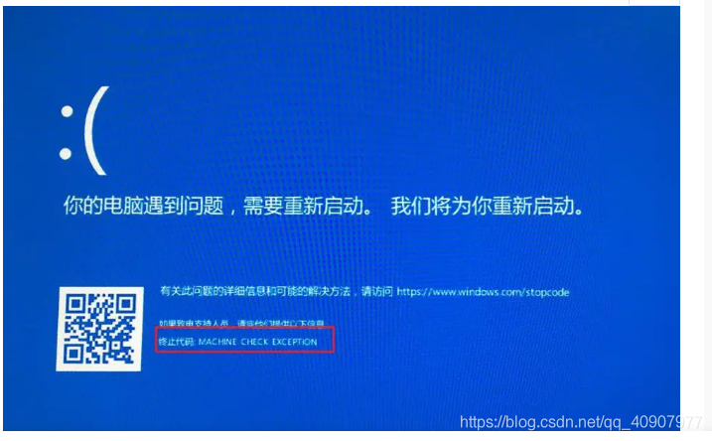
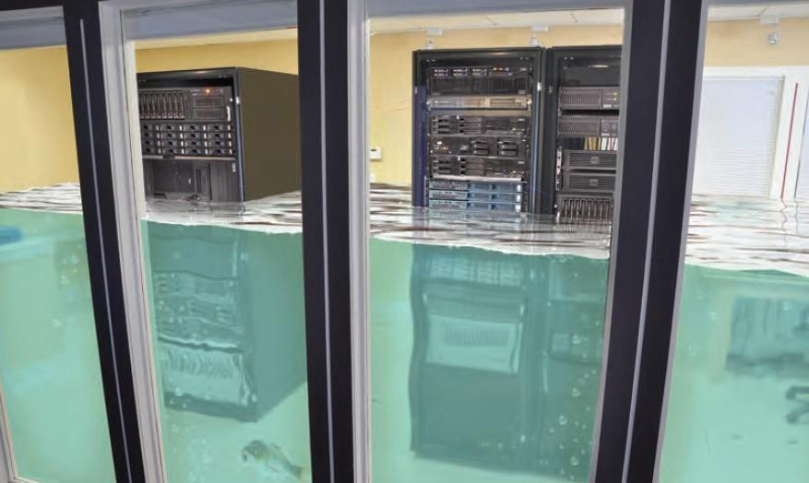

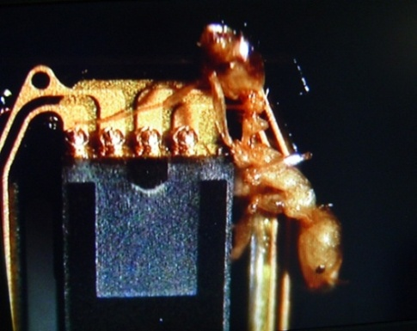
Processes are unreliable

Slide 19



Distributed systems
single machine
distributed systems
Solution
Put more nodes
Orchestrate them using some smart distributed algorithm

Slide 20
Our main focus
Multiparty Interactions
Multiple machines administered by a single party
distributed data store, distributed database systems
Perhaps among mutually untrusted parties
Byzantine Fault-Tolerance (Blockchain), Multiple-party Computation
distributed systems

Slide 21

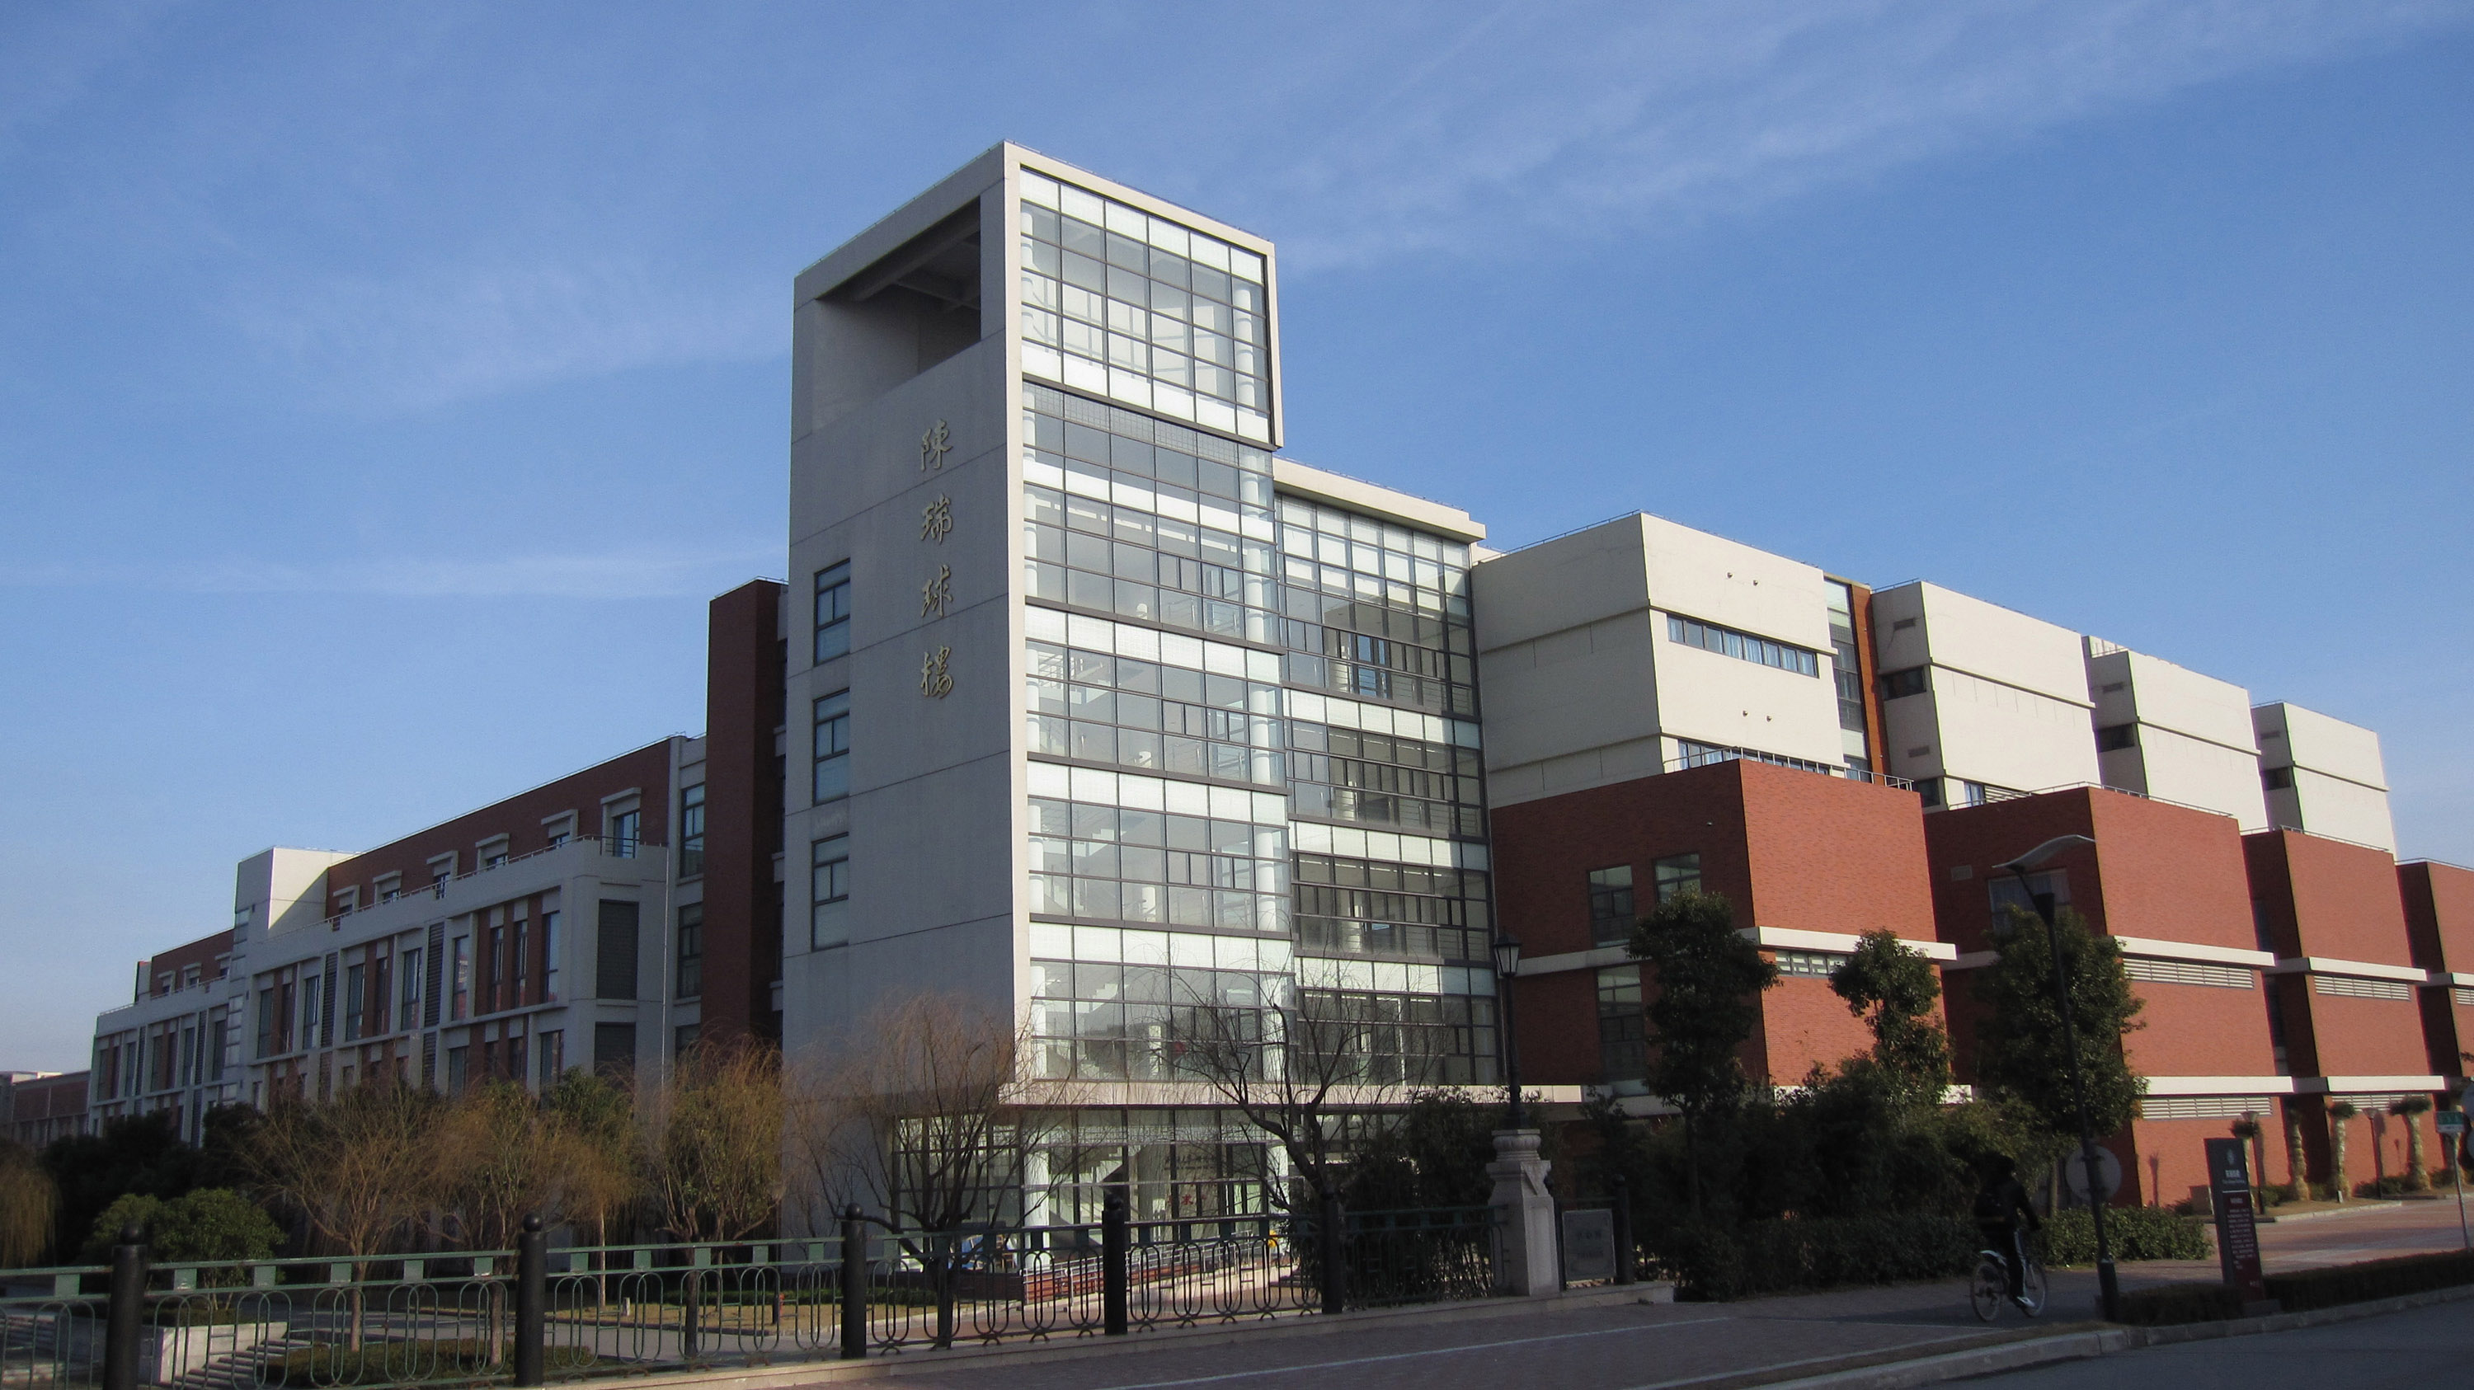
Main Challenges in distributed systems
Processes do not have global view of the system
Inherent
Failures
Asynchrony
Especially failures + asynchrony
Often impacts solvability!
Concurrency
These are our main “enemies”

Slide 22
Challenges: node failure
How do we build a reliable distributed system if
Processes crash
Omit to send/receive messages (e.g., buffer full)
Processes are malicious
Malicious/arbitrary/Byzantine failures

Slide 23
Challenges: asynchrony (network failure)
How do we go about communication asynchrony?
Network failure (e.g., of a switch) may cause messages to be dropped or delayed
Different process speeds → asynchrony

Slide 24


Problem w/ network faults
detecting a process failure (with the help of timing assumptions) is unreliable!
heartbeat message
A
network fault？
B
process fault?
after 2∆ time

Slide 25
Problem w/ network faults
Even worse …
heartbeat message
A
B
heartbeat message
A
B

Slide 26
How?
Specifications
Formalization of a problem
Assumptions
Model
Algorithms
Correctness wrt. Specification
Performance

Slide 27
Specifications
Any specification can be expressed in terms of
Safety
Liveness
nothing else
Safety
Property that states that nothing bad should happen
Liveness
Property that states that something good should happen

Slide 28
Example
Safety: not lying
Liveness: talking something
Combining safety and liveness: (always) telling the truth
Useful distributed services are supposed to provide both liveness and safety properties

Slide 29
Algorithms
Give solution
Prove correctness wrt. Specification
“Correctness may be theoretical,
but incorrectness has practical impact”
Analyze complexity
Time complexity (impacts latency)
Message complexity (impacts throughput)
Coding
We will use pseudocode
No specific programming language

Slide 30
Goals
Fundamentals of distributed computing
Focus on abstractions, solvability, impossibilities
Reasoning about complex interactions
Correctness vs. optimal performance
Theoretical approach (algorithms)
Driven by practical problems
Research: To prepare to start a PhD in the field
Practice: To understand the hard issues and how to approach them in practice

Slide 31
Let’s take a look at an example

Slide 32

Common decision-making problem
Army A has two divisions and two battle plans bp1 and bp2
Two divisions communicate through messengers (can be arrested by B)
Initial state: {no,no}, indicating that no decision has been made
Our goal: {yes,yes}, indicating that a decision has been made on both sides, and there is no need for messages to be exchanged
Army A1
(general-in-chief)
Army A2
hilltop
hilltop
messengers
Army B
valley

Slide 33
Common decision-making problem
No message can be modified
Messages can be lost, but eventually some messages are delivered
The algorithm should ensure the following properties:
A final global state cannot contain both yes and no;
If A1 activates the algorithm, then it eventually enters the local state {yes}.
safety or liveness?

Slide 34
Examples
A1
A2
A1
A2
A1
A2
{yes,no}
DECIDE(bp)
{no,no}
DECIDE(bp)
{no,no}
DECIDE(bp)
…
…
ACK(bp)
{no,yes}
ACK(bp)
{no,no}
…
{yes,no}
ACK²(bp)

Slide 35
Impossibility result
Theorem. There is no algorithm solving the common decision-making problem between two processes, if the underlying communication channel is prone to arbitrary message losses.

Slide 36
Proof
A1 and A2 execute successive phases of message exchanges
Proof by contradiction
assume algorithm A uses the fewest communication phases
when A terminates (i.e., {yes,yes}), there is a last phase during which a message is sent, say message m sent by A1 to A2
the last statement executed by A1 cannot depend on whether or not m is received by A2 (because m can be lost)
similarly, the last statement executed by A2 cannot depend on m
m is useless and can be removed
There exists A’with less communication phases

Slide 37
In practice
A1
A2
{no,no}
DECIDE(bp)
…
ACK(bp)
{no,no}
…
{yes,no}

